Slide 1
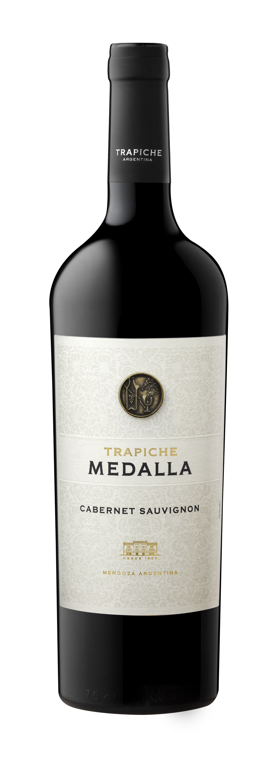
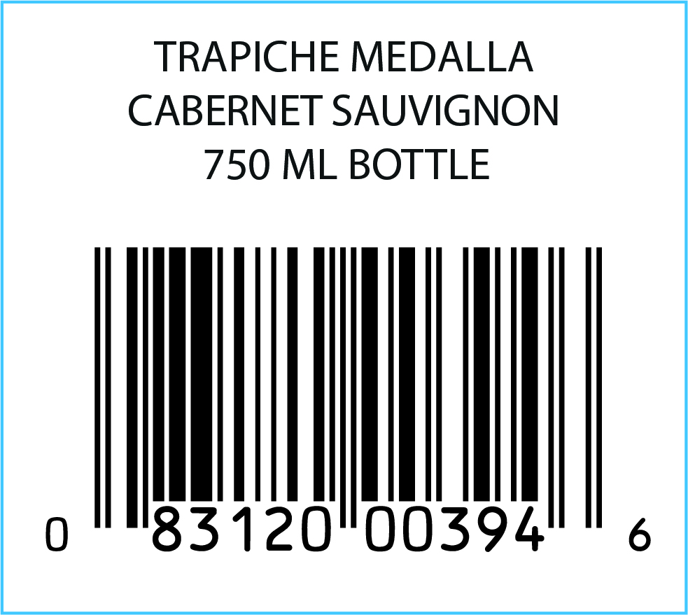
TRAPICHE MEDALLA CABERNET SAUVIGNON
VARIETAL: 100% Cabernet Sauvignon
VINEYARDS: Located in Lujan de Cuyo and Maipú, in the province of Mendoza.
WINEMAKING:
Manual harvesting. Cold maceration in small vats. Natural malolactic fermentation.
BARREL AGING: 18 months in 1st use French oak barrels.
BOTTLE AGING: 6 months
AGING POTENTIAL: 10 years
TASTING NOTES: Intense magenta colored and structured wine. Very complex aromas of plums, green peppers, raisins and subtle woody characteristics. On the mouth, good persistence with soft and ripe tannins.
TECHNICAL DATA:
Alcohol 14%
Sugar: 3.9 g/l.
Total Acidity: 5.73 g/l.
pH: 3.8
FOOD PAIRING: Ideal to combine with smoked fatty meat or stuffed pasta with aromatic sauces.
KEY SELLING POINTS:
Honors the 100th anniversary of the winery's founding.
More than 35 consecutive harvests.
In 2021, Medalla exported 21% of total exports to US.
Made from the oldest vines in the first viticultural zone.
The last 4 vintages got +93 points from more than 6 worldwide competitions.
ACCOLADES:
91 pts James Suckling v16
93 pts James Suckling v17
93 pts James Suckling v18
92 pts James Suckling v20
93 pts James Suckling v21

