Slide 1
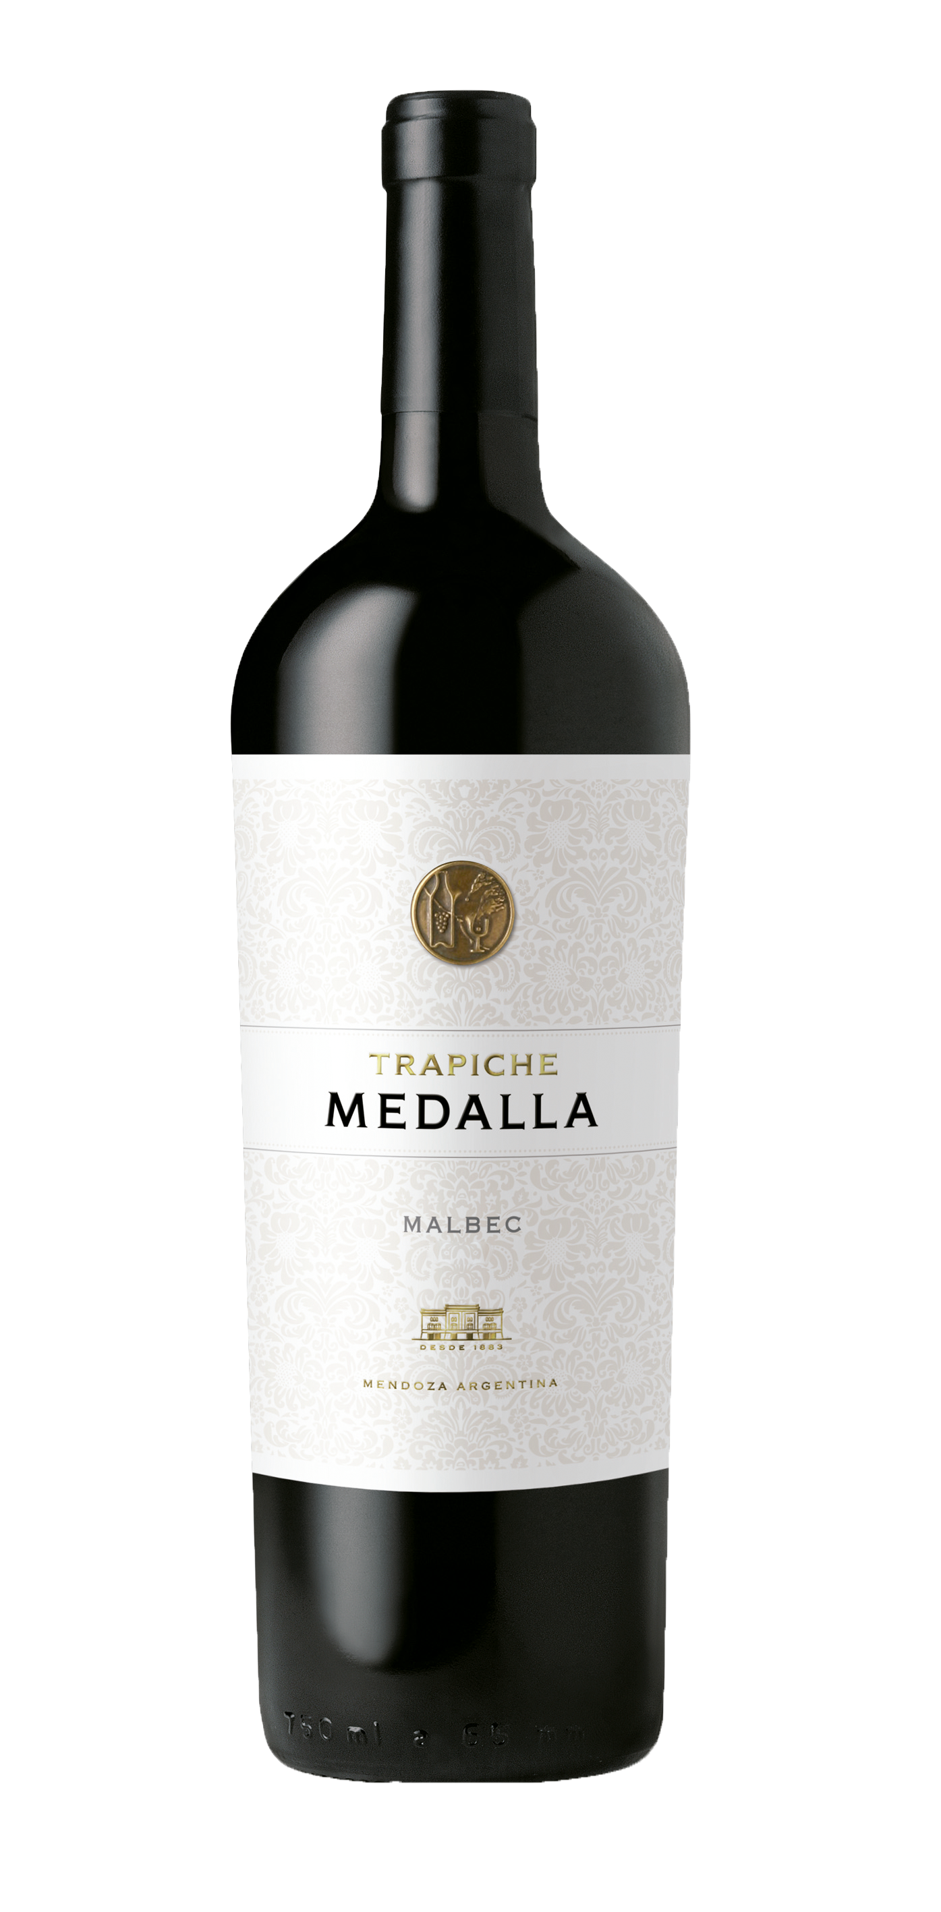
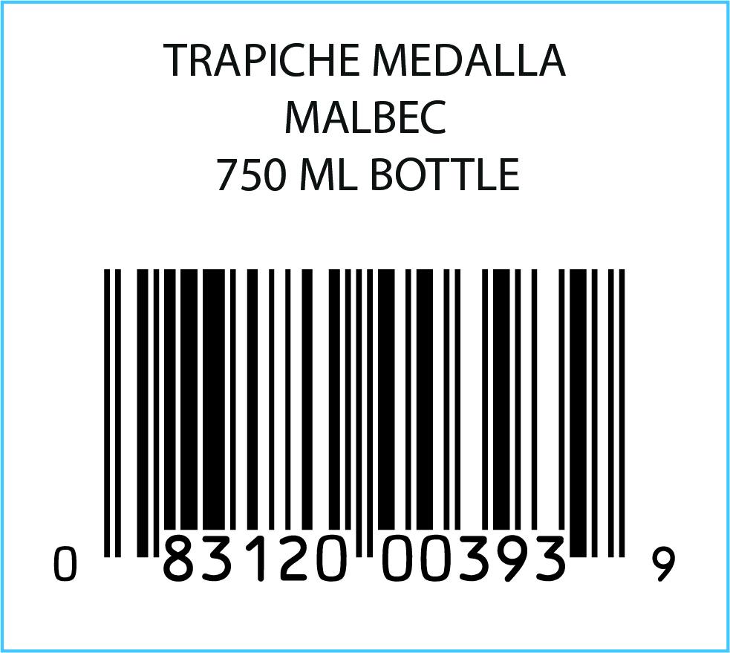
TRAPICHE MEDALLA MALBEC
VARIETAL: 100% Malbec
VINEYARDS: Located in Lujan de Cuyo and Maipú, in the province of Mendoza.
WINEMAKING:
Manual harvesting. Fermentation in small concrete
vats. Natural malolactic fermentation.
BARREL AGING: 18 months in first use French oak barrels
BOTTLE AGING: 6 months
AGING POTENTIAL: 10 years
TASTING NOTES: Intense purple color with violet hints, pronounced aromas of red berries, cherries, and raisins, highlighted by notes of toast, coconut, and vanilla from new French oak barrels. Palate showcases sweet, soft, and intense tannins with creaminess and volume. Ripe fruit notes combine perfectly with spicy, smoky wood for a pleasant and persistent finish.
TECHNICAL DATA: Alcohol 14.5%
Acidity: 5.83 g/l
pH: 3.60
Sugar: 2.89 g/l.
FOOD PAIRING: Excellent for grilled meats, pasta, seasoned cuisine and semi- hard cheeses like Gouda, Gruyere and Edam.
KEY SELLING POINTS:
Honors the 100th anniversary of the winery's founding.
More than 35 consecutive harvests.
In 2021, Medalla exported 21% of total exports to US.
Made from the oldest vines in the first viticultural zone.
The last 4 vintages got +92 points from more than 6 worldwide competitions.
ACCOLADES:
92 pts James Suckling v16
92 pts James Suckling v17
92 pts James Suckling v18
91 pts Best Buy Wine Enthusiast v19
92 pts James Suckling v20
93 pts James Suckling v21

