Slide 1

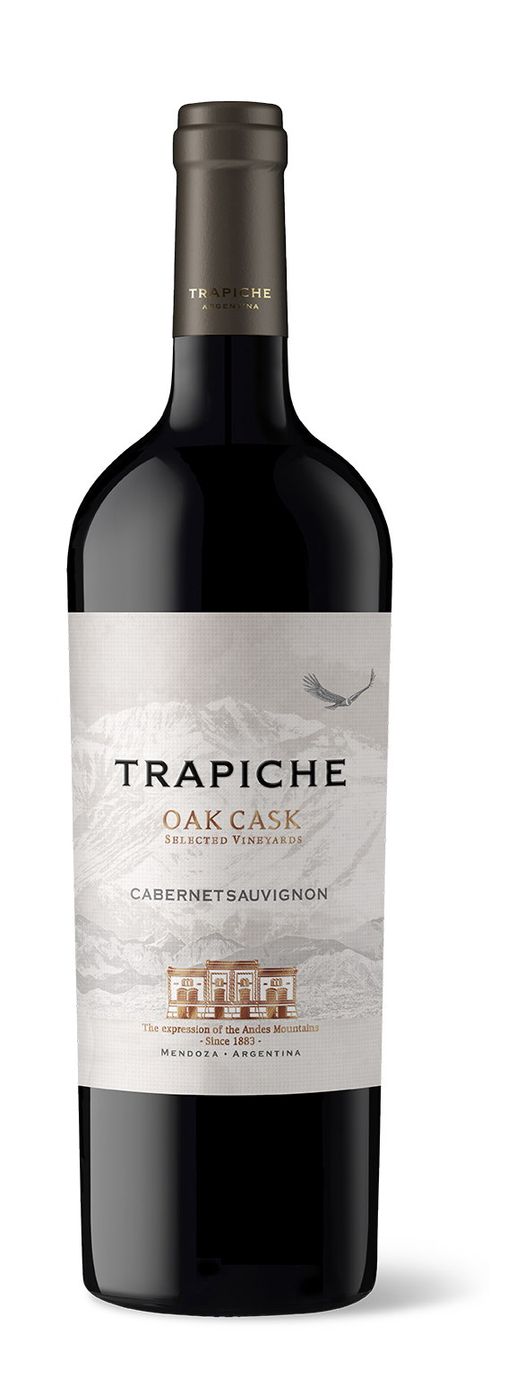
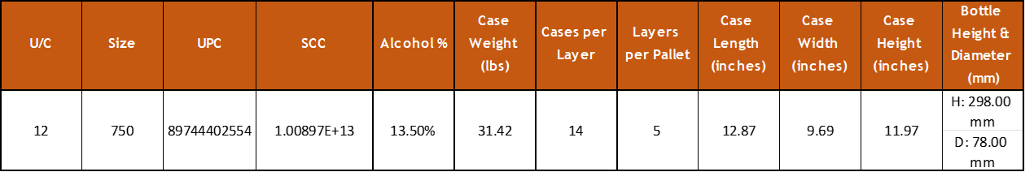
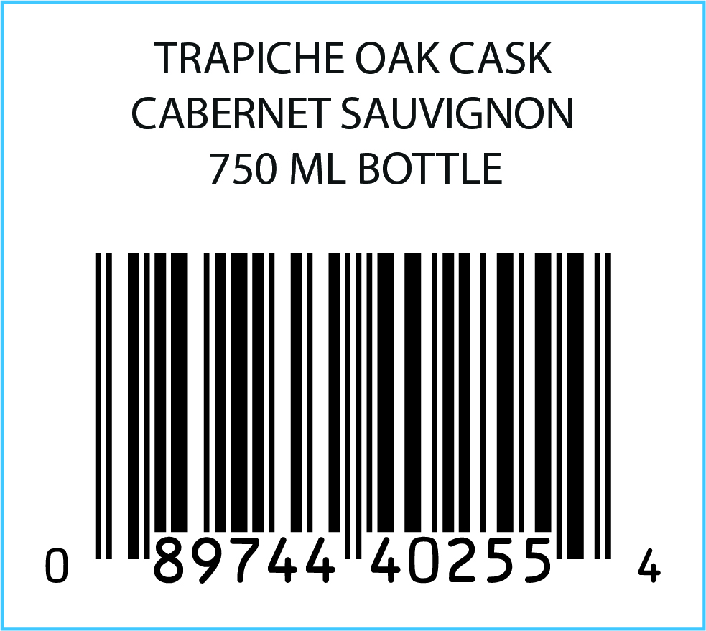
VARIETY: 100% Cabernet Sauvignon
VINEYARDS: Located in the high area of Mendoza’s River, in the Province of Mendoza at altitudes of 2500-3600 feet.
WINEMAKING Manual harvesting and destemming.
PROCESS: Natural malolactic fermentation.
AGING: 9 months in contact with oak
AGING 5 years
POTENTIAL:
MAIN Alcohol: 13.5%
CHARACTERISTICS: Acidity: 5.67 g/l
pH: 3.57
Residual Sugar: 3 g/l
TASTING NOTES: This dark colored wine displays aromas of plums, berries and a touch of licorice. The presence of blackberry and chocolate with a toasted touch on the mouth make this wine pleasant. Fresh and clean on the palate.
FOOD PAIRING: Excellent to pair with duck or spicy roasted chicken. Also good with strong cheeses such as cheddar and blue cheese.
KEY SELLING POINTS: Oak Cask Cabernet sells over 93,000 9LE per year worldwide (in 38 markets).
25.6% of total exports to the US.
+90 points from James Suckling across 7 vintages.
ACCOLADES: 92 pts James Suckling v18
90 pts James Suckling v19
90 pts James Suckling v20
90 pts James Suckling v21
90 pts James Suckling v22

