Slide 1

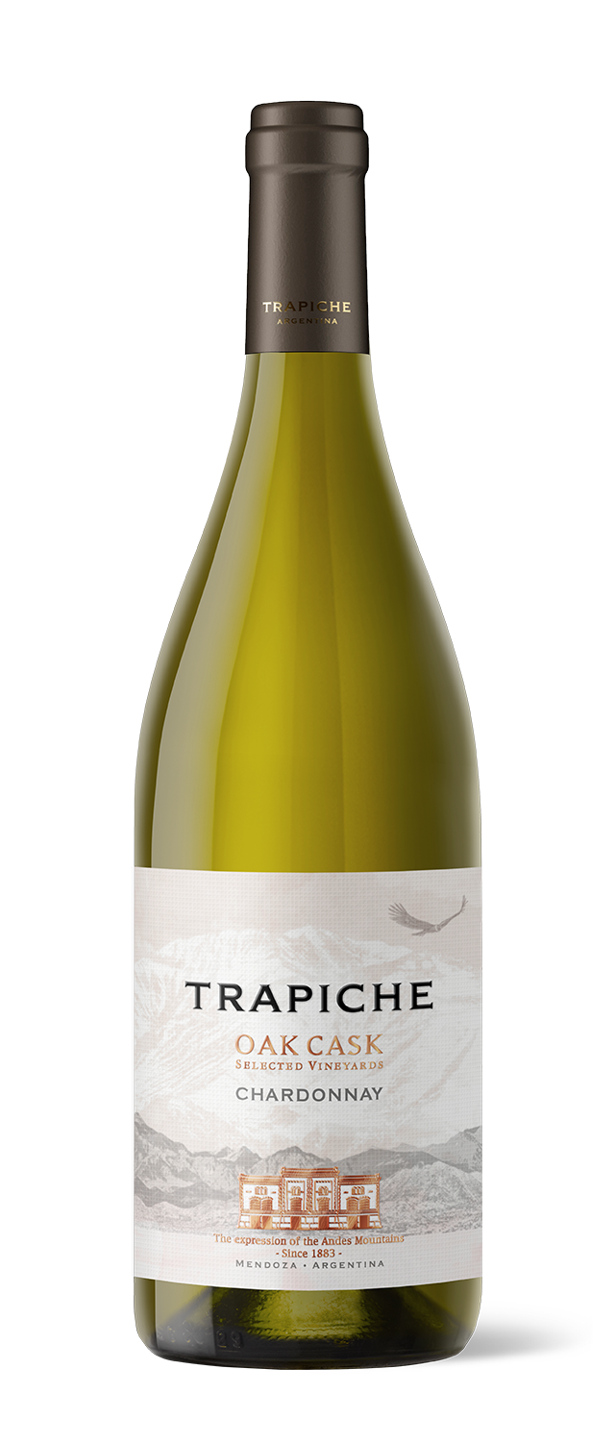
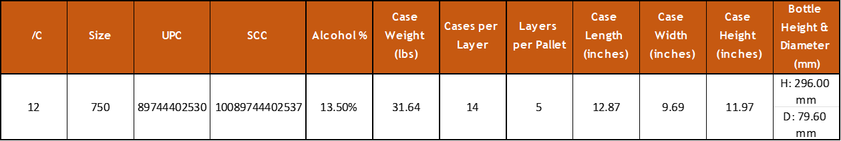
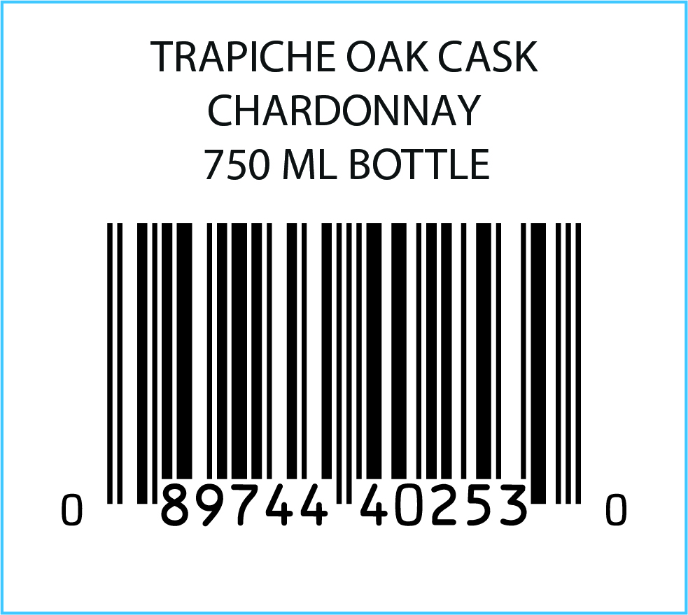
VARIETY: 100% Chardonnay
VINEYARDS: Located in the high area of Mendoza’s River, in the
Province of Mendoza. Vineyards are between 3116- 3937 feet above sea level.
WINEMAKING Manual harvesting and bunch selection. 50% of PROCESS: the wine spends time in stainless steel tanks. Remaining 50% undergoes malolactic fermentation.
BARREL 50% of the wine is aged in French and
AGING: American oak barrels of second and third use.
AGING 5 years
POTENTIAL:
MAIN Alcohol: 13.5%
CHARACTERISTICS: Acidity: 5.17 g/l
pH: 3.62
Residual Sugar: 3.5 g/l
TASTING NOTES: A yellow colored wine with some subtle green hues. Aromas of tropical fruits are perceived on the nose. Elegant flavors, like crème brulée, lemon pie, crisp pear and lemon blossom. Very round on the mouth. Acidity is perfectly balanced.
FOOD PAIRING: Excellent paired with white meats, pasta with white sauce, asparagus or fresh cheese.
KEY SELLING POINTS: Sold in over 85 countries.
Trapiche Oak Cask Malbec is the 1# SKU of the Trapiche portfolio worldwide and exports 25.6% of total exports to the US.
A Legacy of +90 points from James Suckling across 7 vintages.
ACCOLADES: 91 pts James Suckling v21
90 pts James Suckling v22

