Slide 1

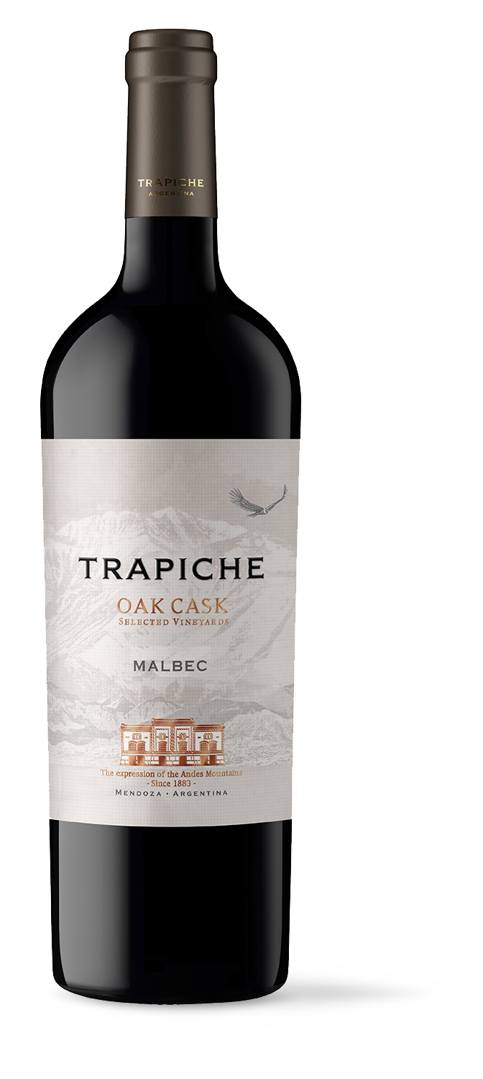
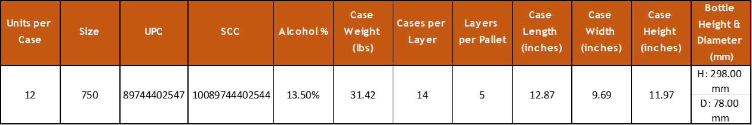
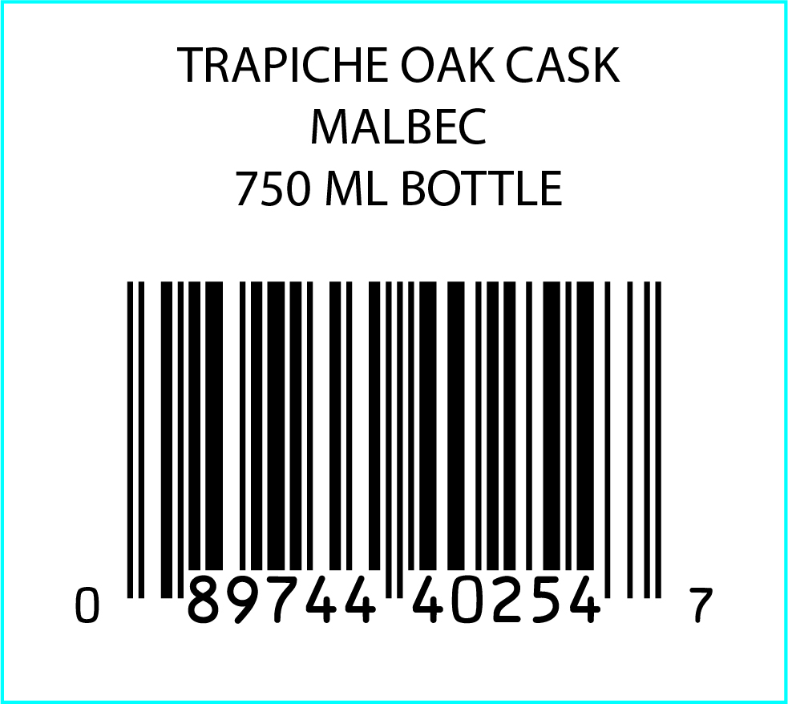
VARIETY: 100% Malbec
VINEYARDS: Located in the high zone of the Mendoza River, in Mendoza Province.
WINEMAKING Manual harvesting and destemming. PROCESS: Natural malolactic fermentation.
AGING: 9 months in contact with oak
AGING 5 years
POTENTIAL:
MAIN Alcohol: 13.5%
CHARACTERISTICS: Acidity: 5.4 g/l
pH: 3.7
Residual Sugar: 2.7 g/l
TASTING NOTES: Intense red wine with some violet hues. Fruity aromas with notes of plums and cherries. In the mouth it is round, with a touch of truffles and vanilla.
FOOD PAIRING: Excellent for grilled meats, pasta, and semi-hard cheeses like Gouda, Gruyere and Edam.
KEY SELLING POINTS: Trapiche Oak Cask Malbec is the #1 SKU of the Trapiche portfolio worldwide with 25.6% of total exports to the US.
Sold in over 85 countries.
Sells over 350,000 9LE per year worldwide +90 points from James Suckling across 7 vintages.
ACCOLADES: 92 pts James Suckling v18
91 pts James Suckling v19
91 pts James Suckling v20
91 pts James Suckling v21
90 pts James Suckling v22

