Slide 1
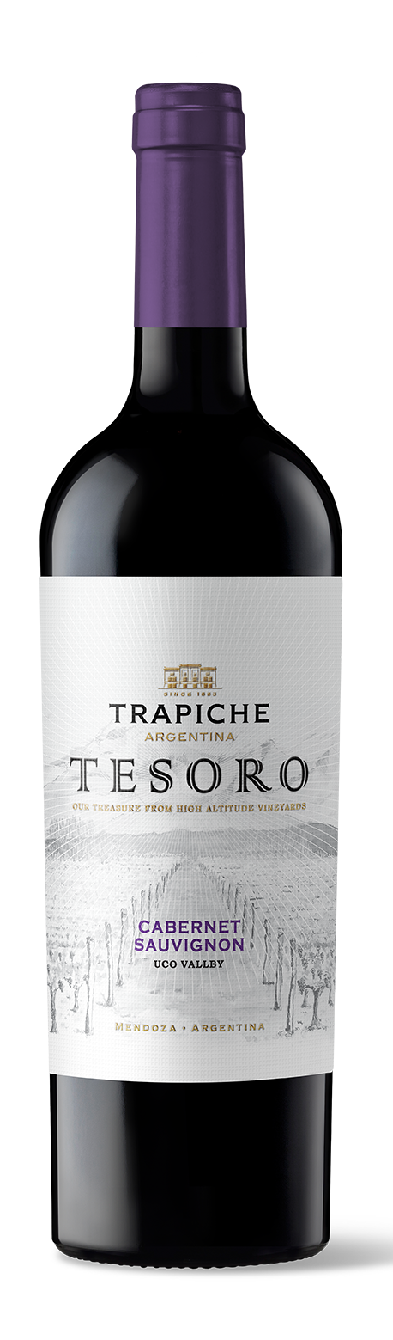

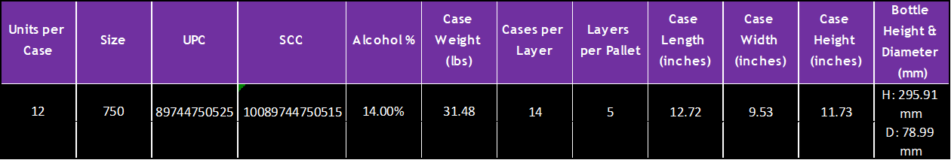
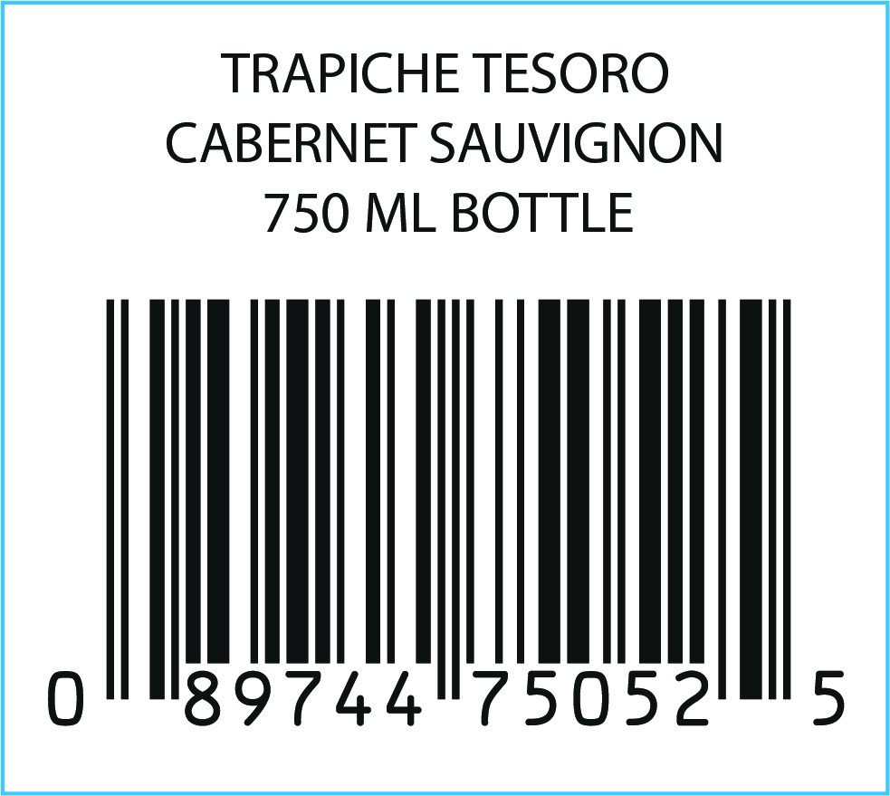
VARIETY: 100% Cabernet Sauvignon
VINEYARDS: Los Arboles, Uco Valley. Alluvial soils, sandy texture with round stones.
WINEMAKING Manual harvesting and destemming. 5 days of
PROCESS: maceration. Fermentation with wild yeasts for 20 days. Malolactic fermentation in contact with oak.
OAK AGING: Oak barrels and second and third use foudres for 13 months (80% French, 20% American)
AGING POTENTIAL: 8 years
MAIN Alcohol: 14%
CHARACTERISTCS: Total acidity: 5.32 g/l
pH: 3.60
Sugar: 2.9 g/l
TASTING NOTES: This Cabernet Sauvignon displays aromas of
cherries and currants, with spice and tobacco notes. It is medium bodied with velvety tannins, fruity and mocha notes on the finish.
FOOD PAIRING: Accompanies grilled meat, spicy dishes, charcuterie and hard cheeses like Parmesan and Pecorino.
KEY SELLING POINTS: The Tesoro concept was validated via US market research: 85% ¨liked it¨ or ¨liked it a lot.” The first brand of Trapiche’s portfolio that was created specifically to export globally.
High altitude vineyards (+4100 feet ASL).
ACCOLADES: 92 pts James Suckling v22

