Slide 1
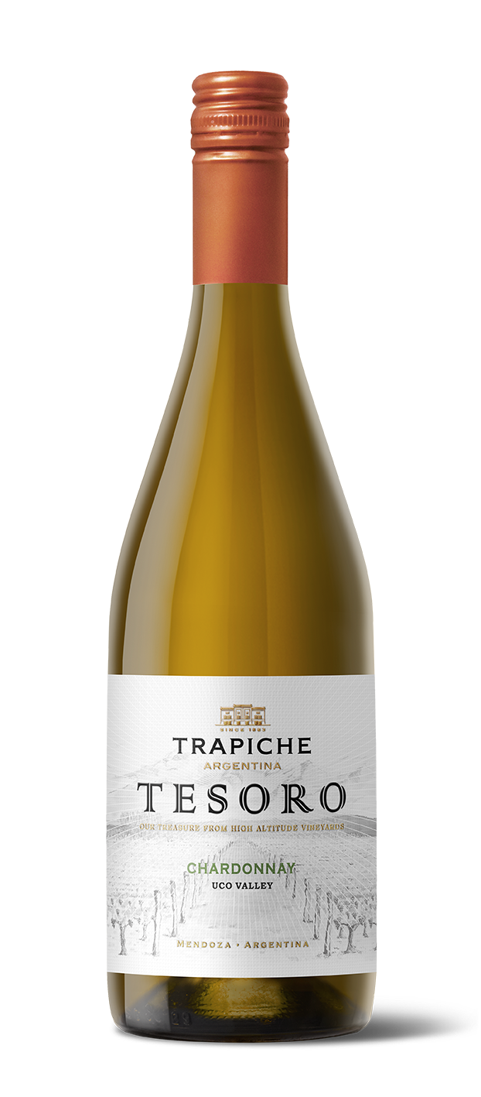

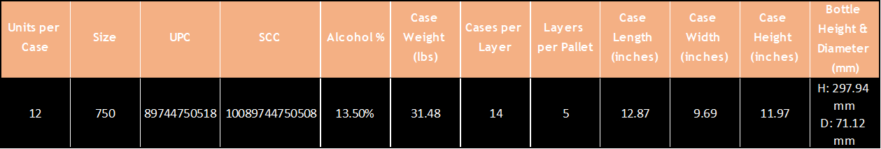
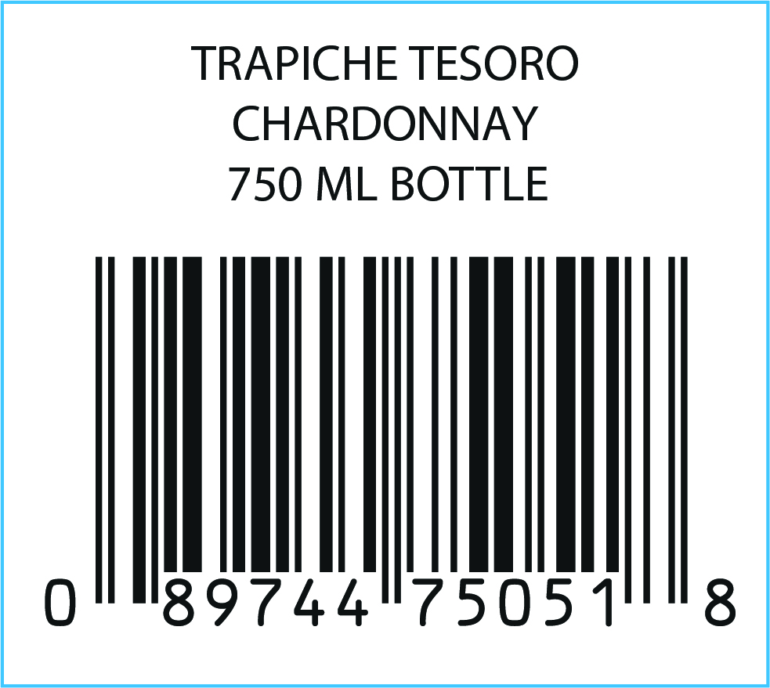
VARIETY: 100% Chardonnay
VINEYARDS: Los Arboles, Uco Valley. Alluvial soils, sandy texture with round stones.
WINEMAKING Manual harvesting and destemming.
PROCESS: 28 days of fermentation including malolactic fermentation in contact with oak.
OAK AGING: Oak barrels and foudres for 12 months (95% and 5% American)
AGING POTENTIAL: 5 years
MAIN Alcohol: 13.5%
CHARACTERISTCS: Total acidity: 5.36 g/l
pH: 3.50
Sugar: 2.8 g/l
TASTING NOTES: This Chardonnay displays aromas of red apples, mango and lemon zest with creamy layers and hints of caramel. It is medium bodied with some buttery creaminess on the finish.
FOOD PAIRING: Perfect to accompany seafood, fish, white meat
and pasta. Also, wonderful to match with seasonal fruit and white cheeses.
KEY SELLING POINTS: The Tesoro concept was validated via US market research: 85% ¨liked it¨ or ¨liked it a lot.” The first brand of Trapiche’s portfolio that was created specifically to export globally.
High altitude vineyards (+4100 feet ASL).
ACCOLADES: 91 pts James Suckling v21
91 pts James Suckling v22

