Slide 1
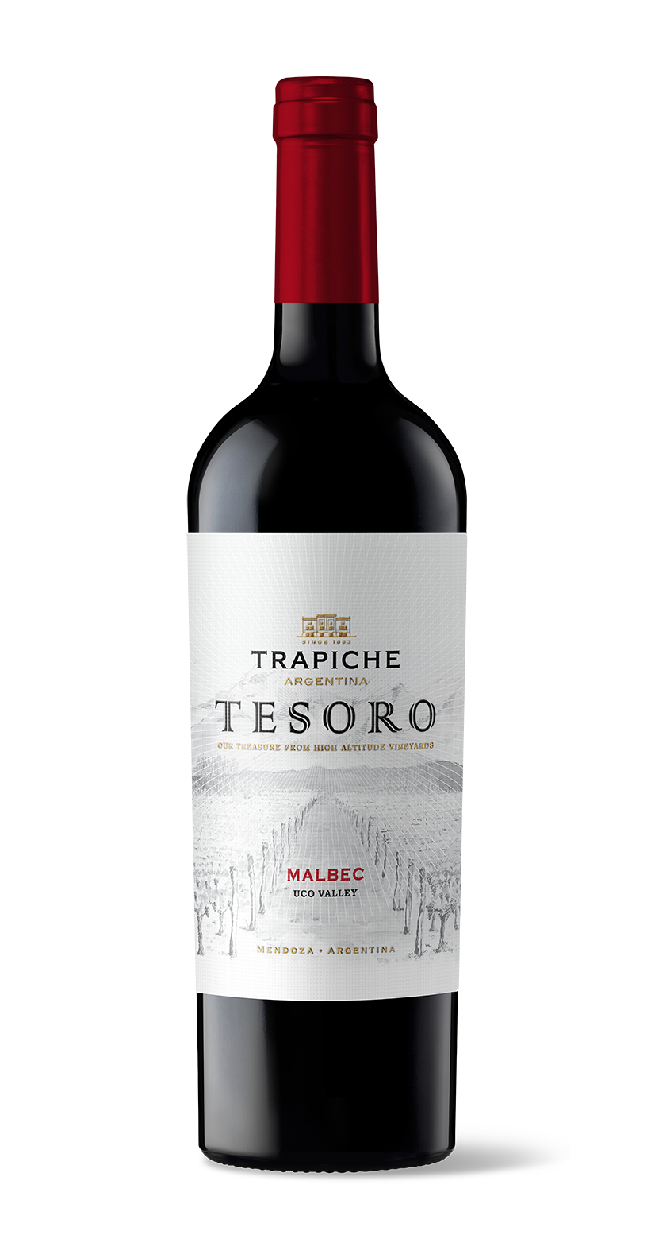

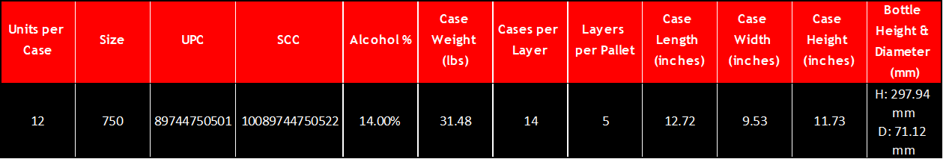
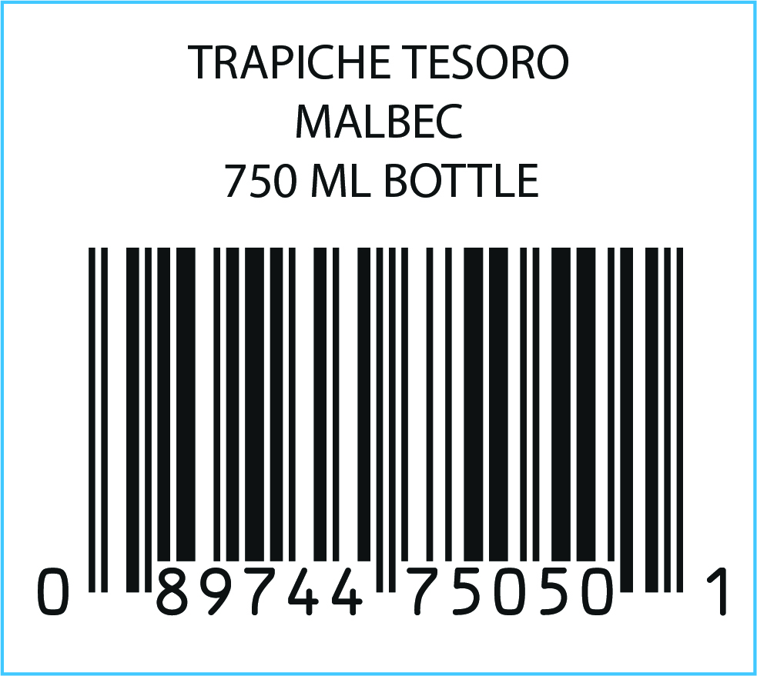
VARIETY: 100% Malbec
VINEYARDS: La Consulta andChacayes, Uco Valley, Mendoza. Alluvial soils with round stones.
WINEMAKING Manual harvesting and destemming.
PROCESS: 3 days of maceration. Fermentation with wild yeasts for 18 days. Malolactic fermentation.
OAK AGING: Oak barrels and second and third use foudres for 13 months (80% French, 20% American).
AGING POTENTIAL: 8 years
MAIN Alcohol: 14%
CHARACTERISTCS: Total acidity: 5.36 g/l
pH: 3.50
Sugar: 2.8 g/l
TASTING NOTES: This Malbec shows aromas of red fruits like plums mixed with notes of vanilla and black pepper. It is medium bodied with very smooth tannins.
FOOD PAIRING: Perfect to accompany grilled meat, stews and
pasta with mushroom sauce. Also, excellent partner of cheeses.
KEY SELLING POINTS: The Tesoro concept was validated via US market research: 85% ¨liked it¨ or ¨liked it a lot.” The first brand of Trapiche’s portfolio that was created specifically to export globally.
High altitude vineyards (+4100 feet ASL).
ACCOLADES: 92 pts James Suckling v21

