Slide 1
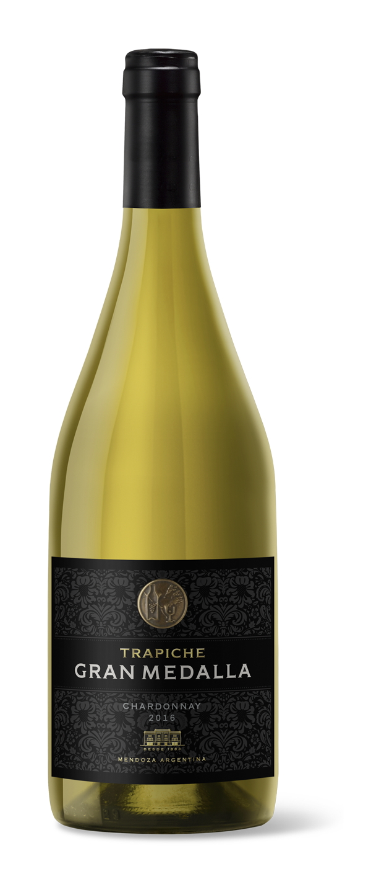
2020 CHARDONNAY
MENDOZA • ARGENTINA
VARIETAL
100% Chardonnay
BARREL AGING
Aged for 9 months in
French oak casks.
BOTTLE AGING
6 months
AGING POTENTIAL
10 years
ACIDITY
6.5g/l
pH
3
ALCOHOL
14.5%
RESIDUAL SUGAR
2.5g/l
VINEYARDS
The grapes come from selected parcels of our Finca El Tomillo Vineyard, in Gualtallary, Uco Valley, Mendoza, at an altitude of 4300 feet. The soil is alluvial, with a coarse texture, and is roughly 10% rocky, lending this Chardonnay freshness and minerality.
WINEMAKING
Controlled alcoholic fermentation with indigenous yeast at 59°F in French oak casks and egg-shaped vessels.
TASTING NOTES
This Chardonnay expresses aromas of tropical fruit, combined with notes of citrus and orange blossom and a touch of spice and brioche. It is fresh and mineral, with a great concentration of fruit in the mouth and has a sensational finish.
FOOD PAIRING
This is where you will put the food pairing information.
ACCOLADES
94pts, James Suckling, v.2019
94pts, James Suckling, v.2020
93pts, Tim Atkin, v.2021
94pts, James Suckling, v.2022
93pts, Vinous, v.2022
94pts, Vinous, v.2023
Crafted as a homage to the winery’s 125th anniversary, Trapiche Gran Medalla seeks to honor our way of making history, which is why this exceptional wine has been sourced from the best vineyards in the iconic Uco Valley.
TRAPICHE.COM.AR

