Slide 1
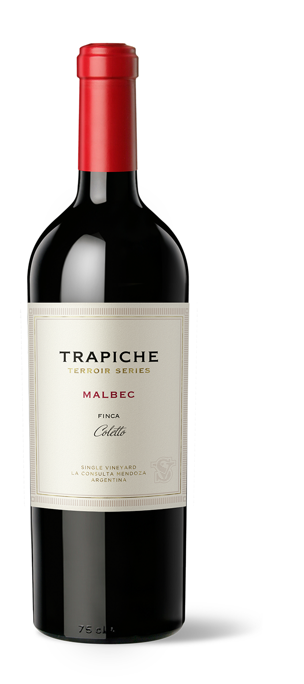
2018 MALBEC
FINCA COLETTO
VARIETAL
100% Malbec
BARREL AGING
Aged for 18 months in new French oak barrels.
BOTTLE AGING
12 months
AGING POTENTIAL
15 years
ACIDITY
5.7 g/l
pH
3.7
ALCOHOL
15%
RESIDUAL SUGAR
2.4 g/l
VINEYARDS
The grapes come from 12-year-old vineyards located in Gualtallary, Tupungato, Mendoza at an altitude of 4300 feet. The soil is sandy with calcareous gravel, which lends the wine a marked minerality.
WINEMAKING
Fermentation with indigenous yeasts in small concrete pools and concrete eggs for a minimum of 25 days at 79°F – 82°F.
TASTING NOTES
A deep red color with bright ruby hues, this exemplary wine presents intense aromas of red fruits, with smoked and spicy notes, and a touch of graphite. In the mouth it is fruity and mineral, with a persistent finish.
FOOD PAIRING
An ideal wine to pair with red meats and game, it also lends itself to accompany hard cheeses and cold cuts.
ACCOLADES
94pts, James Suckling, v2018
94pts, James Suckling, v2019
94pts, James Suckling, v2020
94pts, James Suckling, v2021
95pts, James Suckling, v2022
Since it’s early days, Trapiche has made extensive forays into terroirs that offer extraordinary potential, following a philosophy inspired by the richness in diversity. The Terroir Series embodies diversity in its range of wines from different growers & different soil.
TRAPICHE.COM.AR

