Slide 1
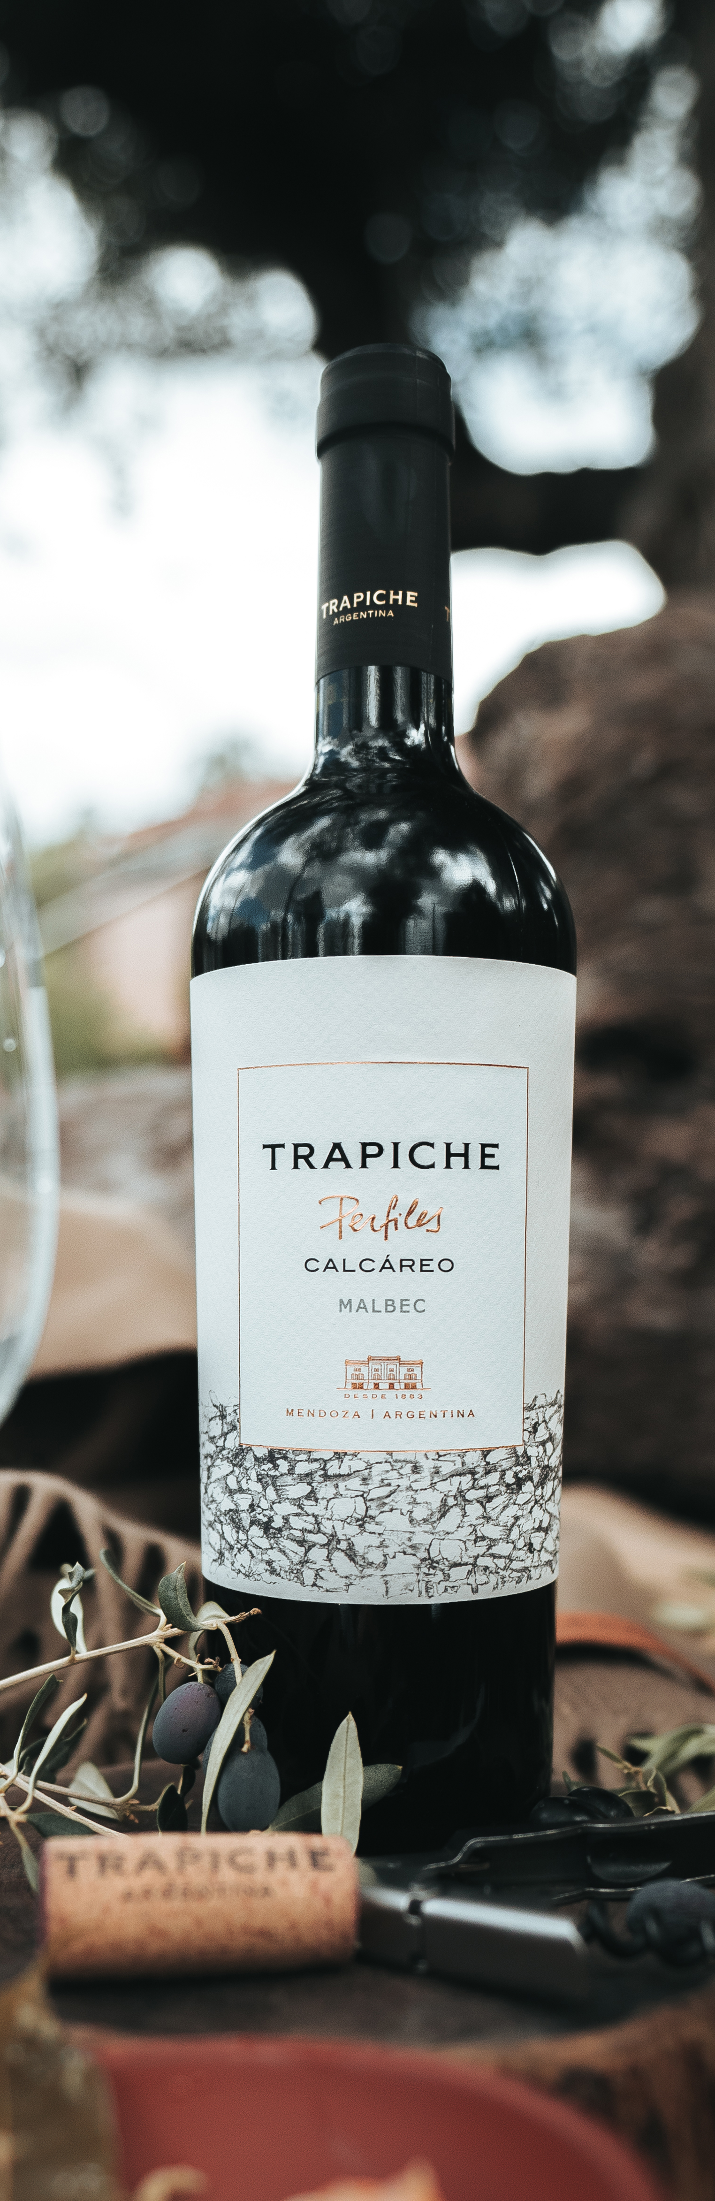

A wine which knows that the most important thing
is what lies beneath the surface.
Trapiche Perfiles explores the best soils of
mendoza to achieve wines of maximum expression.
Revealing the diversity of Mendoza....
Stimulating the senses.
VARIETAL COMPOSITION
100% Malbec
VINEYARDS
Gualtallary, Tupungato, Mendoza.
Altitude: 4,300 feet above sea level
SOIL
Calcareous soil
WINEMAKING PROCESS
Hand harvesting. Fermentation with indigenous yeasts and maceration in small cement tanks for a minimum of 15-18 days at 23°C - 25°C. Natural malolactic fermentation in French oak foudres for 6 months. Coarse filtration.
Bottled after 1 winter.
TECHNICAL INFORMATION
• Alcohol: 14.5%
• Total Acidity: 6.23 g/l
• pH: 3.58
• Sugar: 2.90 g/l
TASTING NOTES
A Malbec full of vibrant energy with a calcareous soil profile at more than 4,300 feet above sea level. Struggling to survive in these extreme conditions; the plant has developed a unique resistance. This results in robust, independent wines. Tannins play an enormous role in this enchanting wine with great persistence on the palate. It is best enjoyed with food.
91
POINTS
“High altitude vineyards contribute to a concentrated Malbec,
with chalky tannins and deep black and blue fruit notes. Finishes elegantly with violets and mocha.”
Janruary 2023 | Vintage 2021

