Slide 1
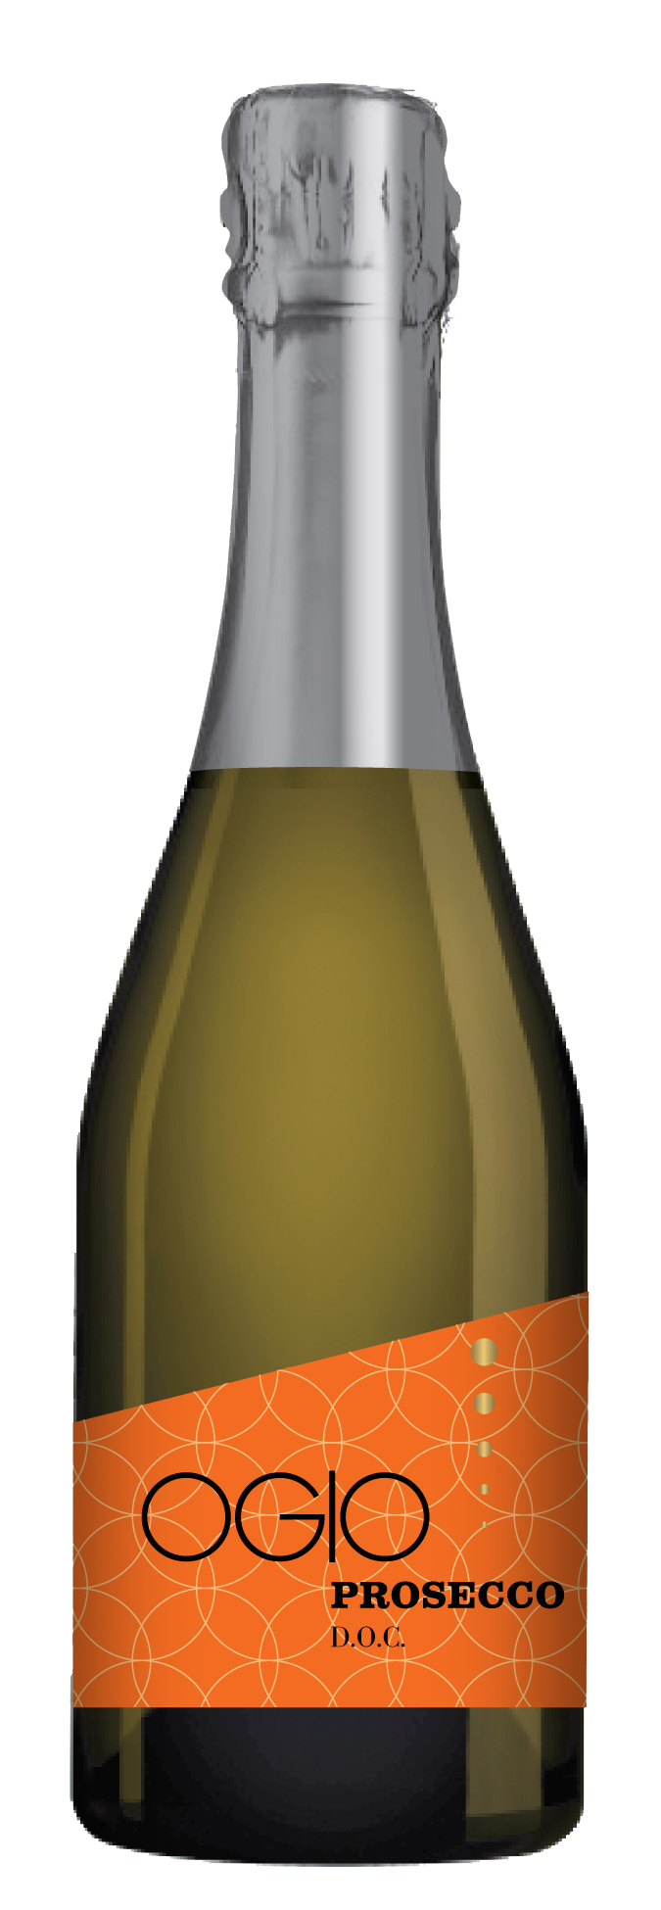
PROSECCO
Prosecco D.O.C.
EXTRA DRY SPARKLING WINE
NEW187ml sized bottles!
Toast life, the Italian way. Ogio wines capture the Italian ideal of unequivocal good taste. Treat yourself to a little dolce vita today!
TASTING NOTES
Delicate pear and melon notes give this wine its bubbly sweetness. With floral aromas and a fresh and fruity finish.
APPELLATION
The small geographic area of Prosecco is well known for it's steep, rolling hills, leafy riverbanks and abundant vineyards. It's Alpine breezes and sunny days make it the perfect region for sparkling wine.
FOOD PAIRING
These little bottles are perfect for celebrations, hors d'oeuvre and sushi.
  ALC: 11%
©2018 WX IMPORTS, NOVATO, CA

